Slide 1
Principles and Ethics of Artificial Intelligence
Module 1
Hazina Assist.prof. Dcsku

Slide 2
Artificial intelligence (AI)
The ability of machines to replicate or enhance human intellect, such as reasoning and learning from experience.
AI uses techniques from probability theory, economics, and algorithm design to solve practical problems.
Although the concept of AI has been around since the 19th century, when Alan Turing first proposed an “imitation game” to assess machine intelligence, it only became feasible to achieve in recent decades due to the increased availability of computing power and data to train AI systems.

Slide 3
think about what distinguishes human intelligence from that of other creatures ?
Ability to learn from experiences and apply these lessons to new situations.
AI??
one significant advantage over us: their ability to analyze vast amounts of data and experiences much faster than humans could ever hope.

Slide 4
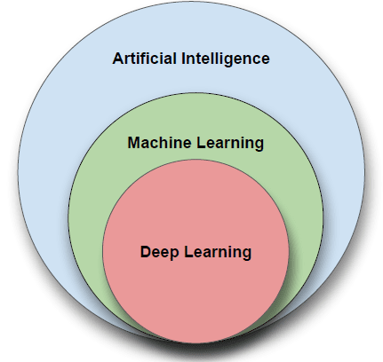
AI can be broken down into two major fields, Machine Learning (ML) and Neural Networks (NN). Both are subfields under Artificial Intelligence, and each one has its methods and algorithms to help solve problems.

Slide 5
History of AI
Artificial intelligence dates back to the late 1940s when computer pioneers like Alan Turing and John von Neumann first started examining how machines could “think.” However, a significant milestone in AI occurred in 1956 when researchers proved that a machine could solve any problem if it were allowed to use an unlimited amount of memory.
The result was a program called the General Problem Solver (GPS).

Slide 6
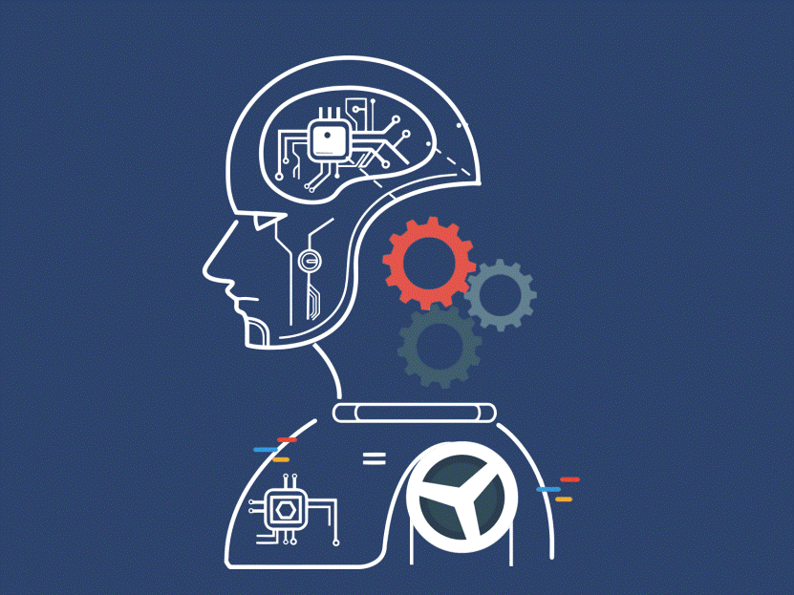
In computer science AI research is defined as the study of "intelligent agents": any device that perceives its environment and takes actions that maximize its chance of successfully achieving Its goals.

Slide 7
Definition,
The study of computer systems that attempt to model and apply the intelligence of the human mind.

Slide 8
Thrust areas ,
Problem solving, planning, and search --- generic problem solving architecture based on ideas from cognitive science (game playing, robotics).
• Knowledge Representation – to store and manipulate information (logical and probabilistic representations)
• Automated reasoning / Inference – to use the stored information to answer questions and draw new conclusions

Slide 9
• Machine Learning – intelligence from data; to adapt to new circumstances and to detect and extrapolate patterns
• Natural Language Processing – to communicate with the machine
• Computer Vision --- processing visual information
• Robotics --- Autonomy, manipulation, full integration of AI capabilities

Slide 10
